Slide 2
Integrate OpenAI into Your Code with Semantic Kernel
Kevin Feasel
feaselkl@solliance.net

Slide 3
Who am I? What am I doing here?
Data & AI specialist at Solliance
Curated SQL
Finding Ghosts in Your Data

Slide 4
Motivation
Review requirements for Azure OpenAI (AOAI)
Gain an introduction to Semantic Kernel
Build Semantic Kernel plugins and use them in C#
Enhance an existing website with Semantic Kernel
Review additional Semantic Kernel capabilities

Slide 5
What We’ll Do

Slide 6
What We’ll Do

Slide 7
What We’ll Do

Slide 8
What We’ll Do

Slide 9
A Brief Warning
Semantic Kernel is new and under heavy development!
Expect frequent API changes
Not an enormous number of samples out there

Slide 10
Agenda
Basic Setup
Trying out Semantic Kernel
Semantic Kernel plugins
Personalize your experience
What comes next?

Slide 11
Azure OpenAI (AOAI)
Built on top of OpenAI
Features typically come in 3-6 months after they appear on OpenAI
Your OpenAI credentials will not work for Azure OpenAI
Currently (December 2023) limited access – registration form needed to whitelist a subscription

Slide 12
Preparing Your Experience
Azure OpenAI has several models available to us
Recommendation: use GPT-4 over GPT-3.5 if possible

Slide 13
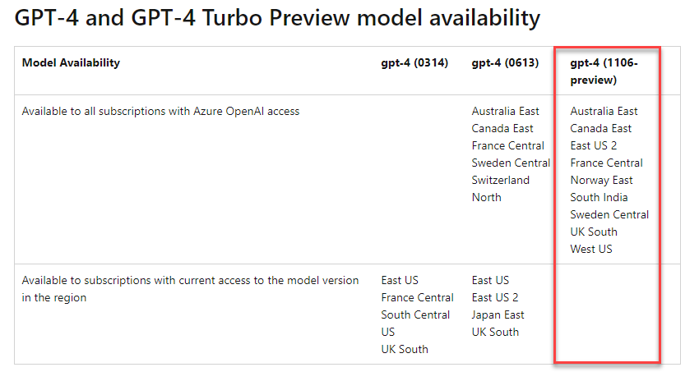
GPT-4 Availability
Access limited to specific regions

Slide 14
So You’ve Been Approved…What Next?
Azure OpenAI service available in Azure Portal

Slide 15
Create an Azure OpenAI Service

Slide 16
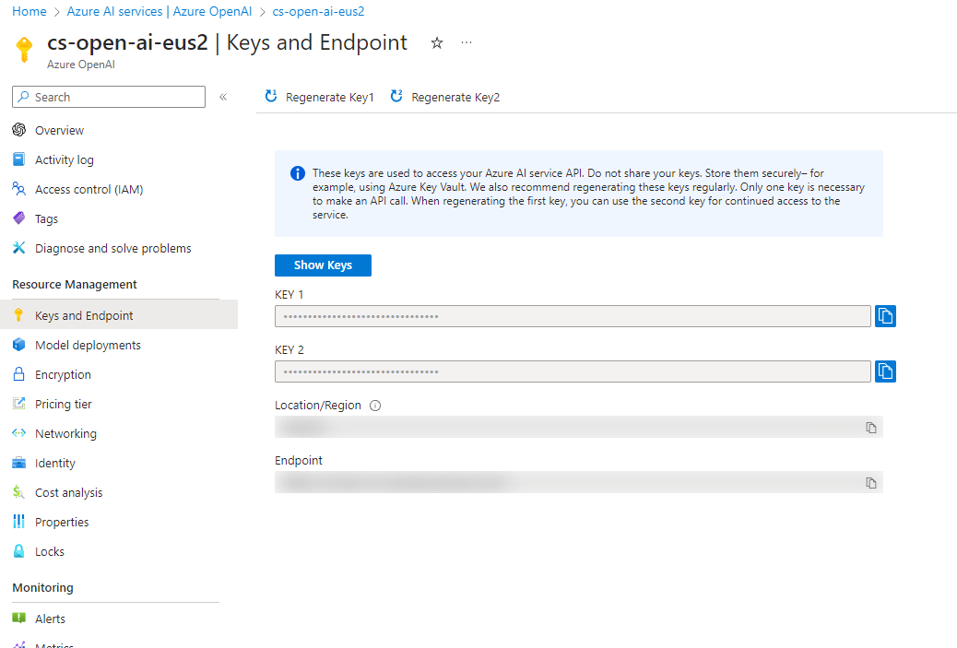
Grab Critical Details
AOAI uses the combination of endpoint + key to provide security

Slide 17
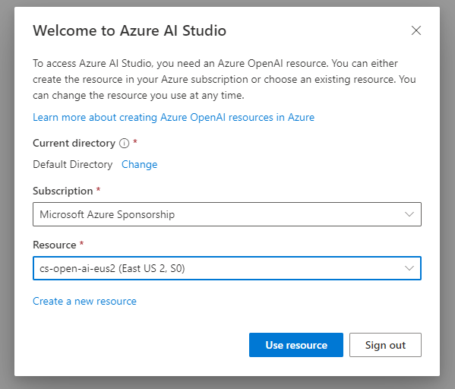
Azure AI UI Options
https://oai.azure.com/portal
Default experience
“Legacy” app but will not go away anytime soon
https://ai.azure.com
New experience
Still in public preview—does not have all functionality yet
Will focus on classic studio (oai.azure.com) today

Slide 18
Build a Deployment
Deployment: custom endpoint to an Azure OpenAI base model or fine-tuned model
Choose a specific variant of a model (e.g., GPT-4 1106-preview)
Enable content filtering
Perform rate limiting
We will want gpt-4 and text-embedding-ada-002

Slide 19
Agenda
Basic Setup
Trying out Semantic Kernel
Semantic Kernel plugins
Personalize your experience
What comes next?

Slide 20
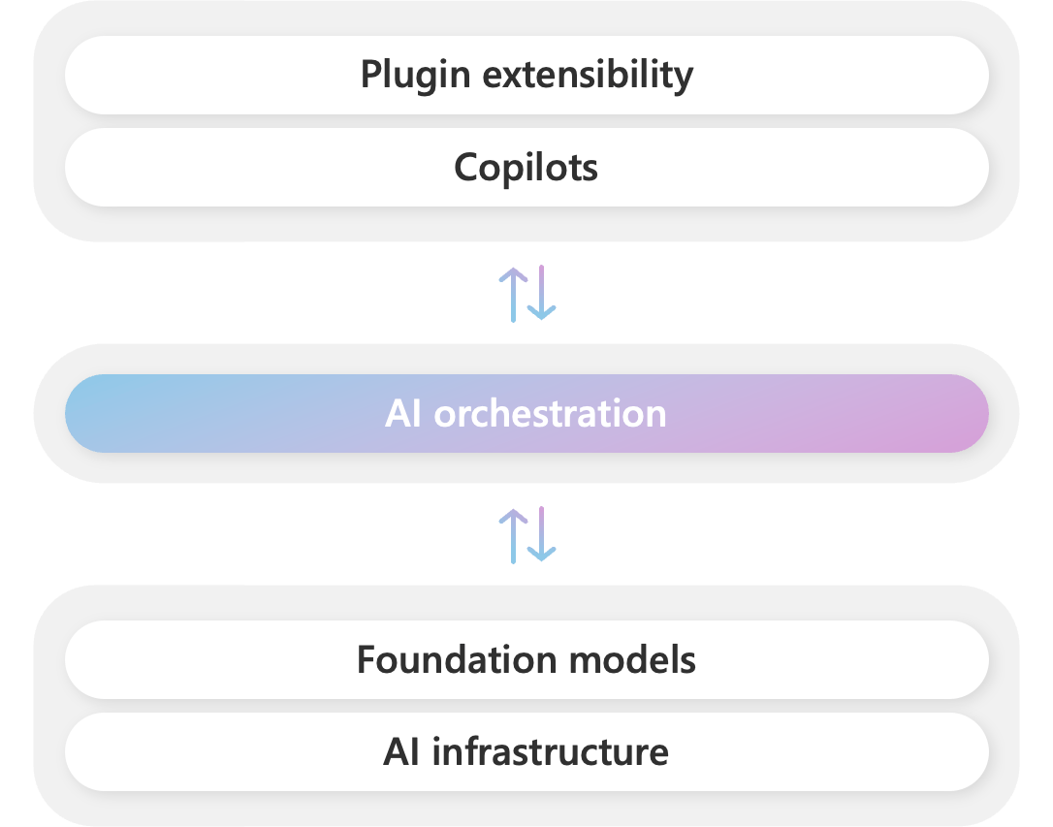
What Is Semantic Kernel?
Open source SDK to integrate OpenAI, Azure OpenAI, and Hugging Face with existing code
Serves as an AI orchestration layer for custom code

Slide 21
Why Would I Use Semantic Kernel?
Supports C#, F#, Python, and Java
Works with your existing code base (.NET Standard 2.0 or later)
Reduces complexity of working with AI services
One API instead of several
Allows iterative operation
Turns AI service operation into pipelines

Slide 22
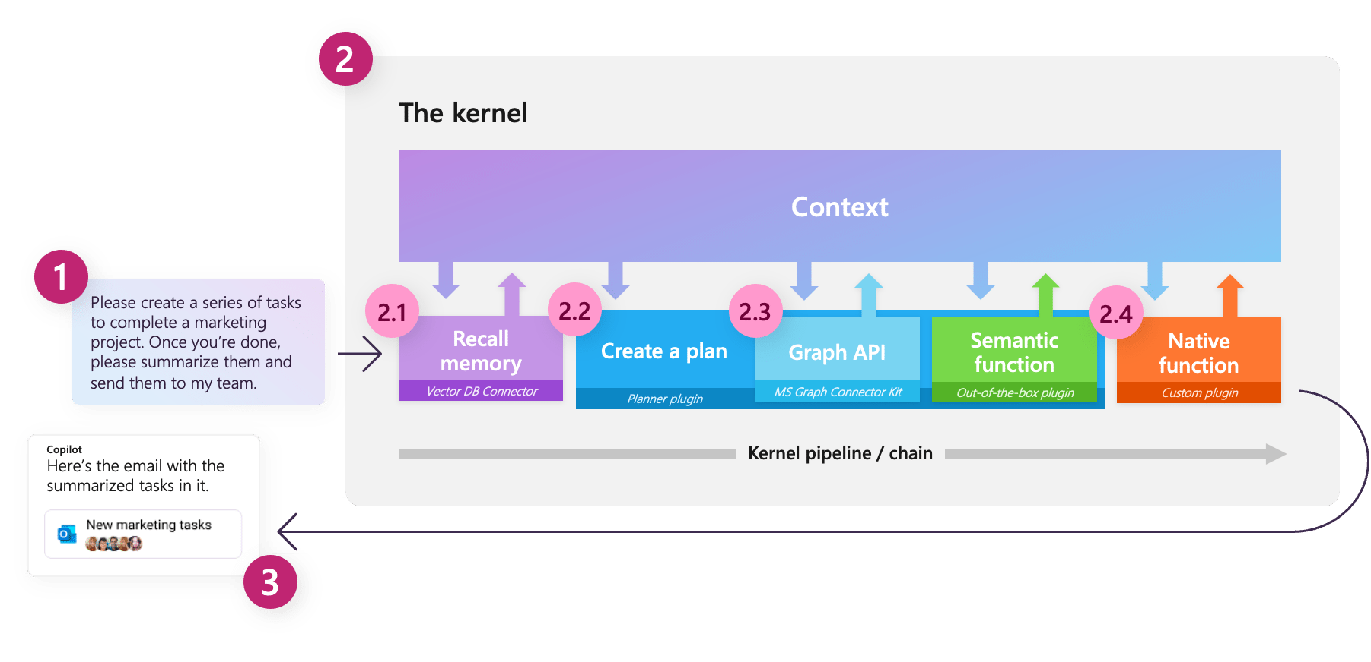
Example Pipeline
Request (1) goes to kernel (2). Kernel orchestrates the user’s request
Pipeline elements access vector DBs (2.1), determine appropriate plugins (2.2), call plugins (2.3), incorporate custom plugins (2.4)
Results sent back to user (3)

Slide 23
Semantic Kernel vs LangChain
LangChain: popular Python-based framework for developing applications powered by language models
LangChain | Semantic Kernel
Open-source library | Open-source library
Great community support | Microsoft support
Easier for prototyping | Easier for integration with existing apps
Nightly builds aren’t always backwards compatible and often introduce new bugs | Still in beta but typically stable

Slide 24
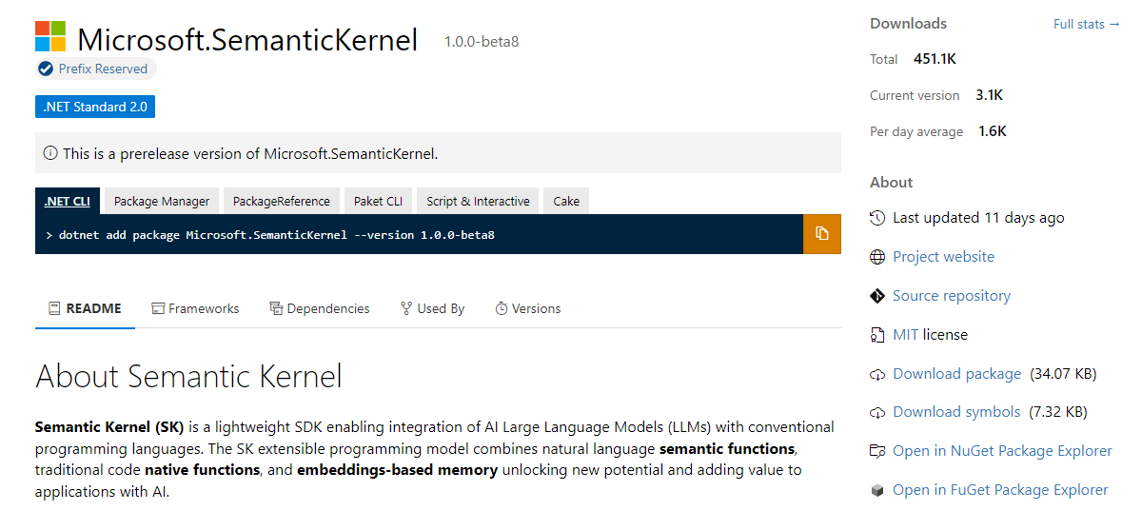
Getting Started in .NET
Needs the Semantic Kernel NuGet package

Slide 25
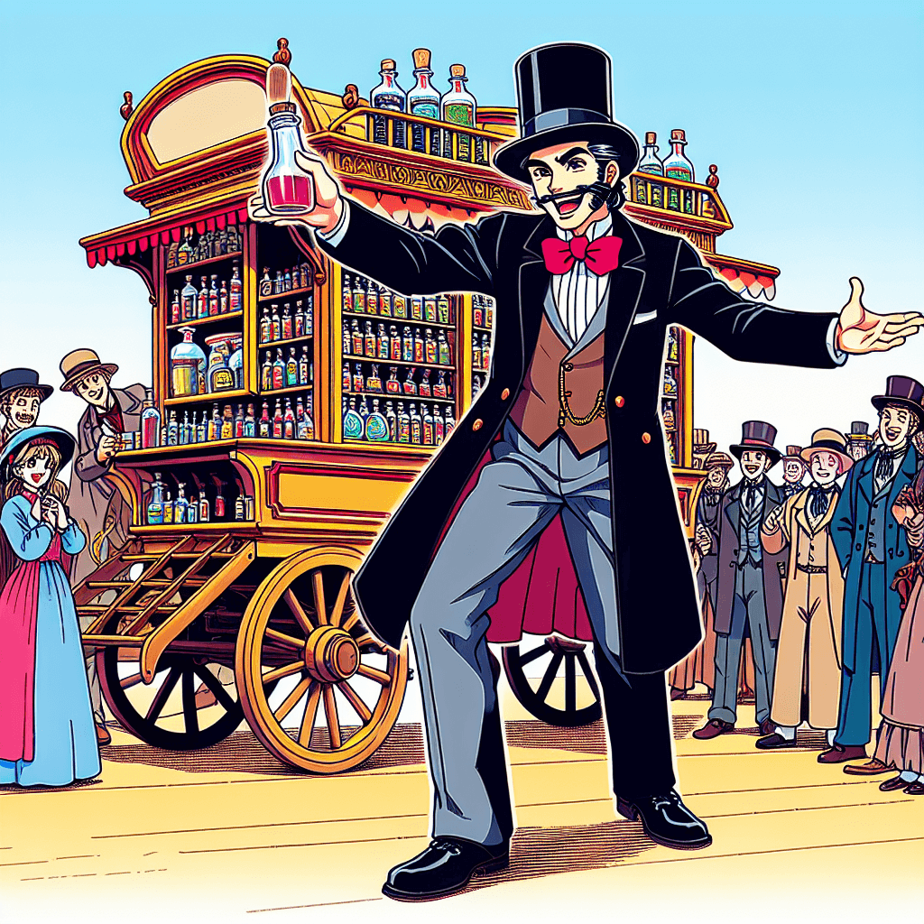
Demo Time!
Try Semantic Kernel in a C# console application
Show a bonus example in F#

Slide 26
Agenda
Basic Setup
Trying out Semantic Kernel
Semantic Kernel plugins
Personalize your experience
What comes next?

Slide 27
Semantic Kernel Functions
Semantic function: prompt sent to an AI service, along with any relevant settings
Native function: task we do not send to an AI service
Retrieve data from a database
Perform complex math
Send an e-mail or execute a workflow
Both semantic + native functions are expressed as SKFunction objects
Pipeline: set of SKFunction objects chained together
Kernel class includes a RunAsync() method to execute this pipeline

Slide 28
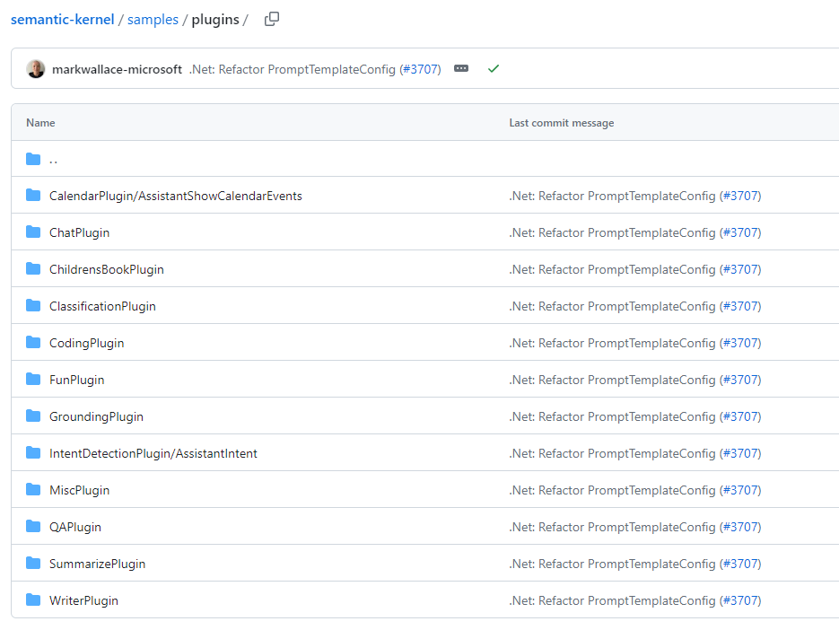
Semantic Kernel Examples
Microsoft has a variety of semantic function examples in the Semantic Kernel repo

Slide 29
Plugin Details
A plugin has two required files:
Config.json – configuration settings for the semantic function
Skprompt.txt – the input prompt you will send
Import plugins from a directory using the kernel function ImportSemanticFunctionsFromDirectory()
Reference specific functions by folder name within the directory

Slide 30
The Planner
Function accepting a request and returns a plan on how to accomplish the request
Can mix and match your semantic and native functions

Slide 31
Planner Types
Basic
Simplified planner combining a set of functions
Python but not .NET
Action
Creates a plan with a single step
.NET & Python
Sequential
Creates a plan with a series of interconnected steps and custom generated input & output variables
.NET & Python
Stepwise
Incrementally performs steps and observes results before performing the next step
.NET & Python

Slide 32
Instantiating a Planner
Takes a kernel and reads all plugins registered to the kernel
var plugins = kernel.ImportFunctions(…);
var planner = new SequentialPlanner(kernel);
The planner is itself a semantic function!

Slide 33
Planning for Failure
Planner performance not guaranteed to be great
Incorporate “waiting on response” in your app
Allow generating partial responses to stream back to the user
Pre-defined plans (generated offline and stored as XML in your project) have one-time performance hit and then can be re-used later
Prompt and generated plan can both be expensive in terms of tokens
Use fewer, higher-order functions (functions that accept functions)
Pre-defined plans will not necessitate generating a new plan
Planner can generate faulty plans
Provide error handling
Could potentially ask the planner to fix the plan

Slide 34
Demo Time!
Include an existing plugin in a C# console app
Incorporating plugins in an MVC website

Slide 35
Agenda
Basic Setup
Trying out Semantic Kernel
Semantic Kernel plugins
Personalize your experience
What comes next?

Slide 36
Memory
Context for a request
Types of memory
Key-value pair
Local storage
Semantic memory

Slide 37
Semantic Memory
Problem: context variables let you pass additional text into prompts but can run into token limits
Semantic Memory is the solution
Data structures able to vectorize and store the meaning of text coming from multiple data sources
Can optionally store source text or other metadata
Data made available to Semantic Kernel via memory connector

Slide 38
What Semantic Memory Does
Represent words or data as vectors in high-dimensional space
Vector: measure of direction and length
Arrows from the origin or some starting location
Key concept
Similar words / data will have similar vectors
Different words / data will have different vectors
Given an input, vectorize it and compare it to other vectors, matching the most similar results
Results not guaranteed to be perfect but often a reasonable match

Slide 39
Embeddings
Encodings of tokens in a high-dimensional vector space
Each dimension corresponds to a learned feature or attribute of the language
Embeddings capture and store the meaning of relationships in a language
Embeddings help a model understand semantic and syntactic relationships between tokens

Slide 40
Demo Time!
Building memories with a volatile in-memory store

Slide 41
Agenda
Basic Setup
Trying out Semantic Kernel
Semantic Kernel plugins
Personalize your experience
What comes next?

Slide 42
What Comes Next?
Image generation
Semantic Memory products
Incorporate web search

Slide 43
Image Generation with Dall-E 2 (and 3)
Requires DALL-E API to be enabled
Not available in all regions!
Ex: DALL-E 3 only available in Sweden Central right now
Uses OpenAI Dall-E 2 to transform image description into image
Uses text-embedding-ada-002 to interpret input and compare to generated prompt

Slide 44
Set up Services

Slide 45
Generate a Random Image

Slide 46
Guess the Topic

Slide 47
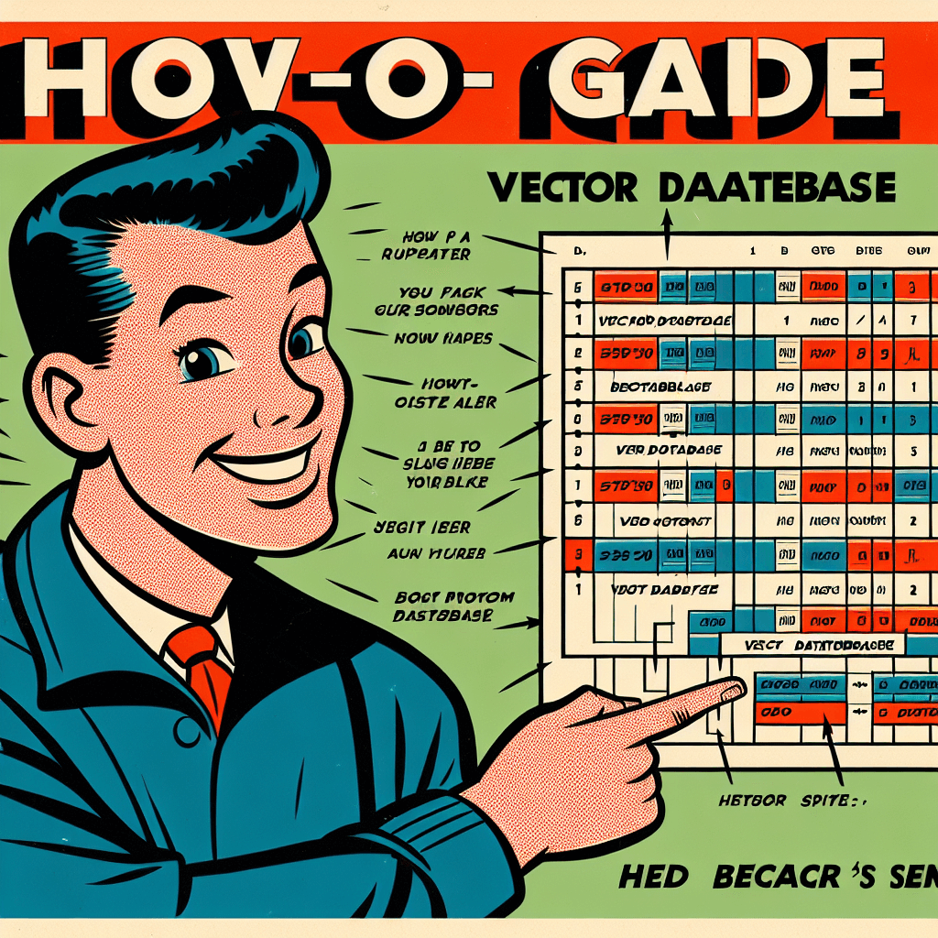
Vector Databases for Semantic Memory
Qdrant
Chroma
Vespa
Marqo
Milvus
Weaviate
Pinecone

Slide 48
Incorporating Web Search
Semantic Kernel can also use external APIs and resources!
Example: use Bing Search to
Required: Bing Search API key
Bing Search support is built into Semantic Kernel:

Slide 49
Executing a Bing Search

Slide 50
Wrapping Up
To learn more, go here: https://csmore.info/on/sk
And for help, contact me:
feaselkl@solliance.net
@feaselkl

Slide 52
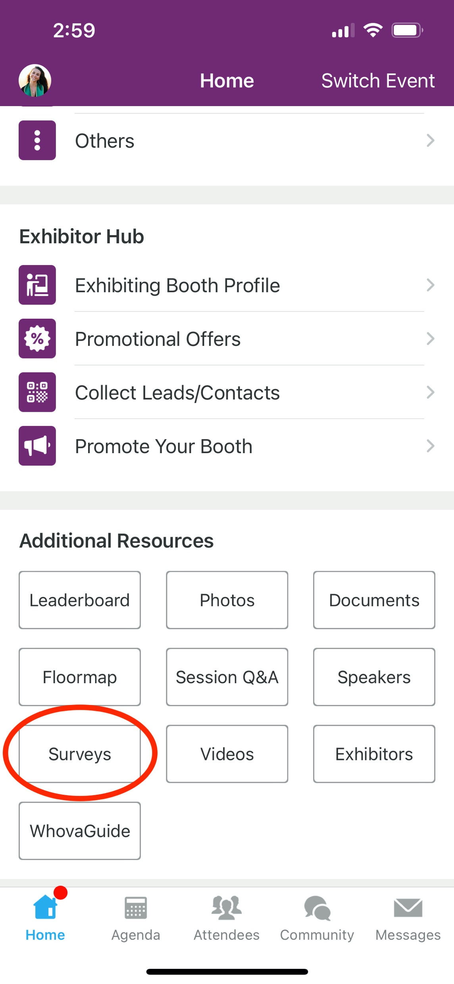
Session Feedback Surveys
We really want to hear from YOU!
In the pursuit of making next year’s Conference even better, we want to hear your
feedback about this session.
Here’s How -
Simply go to the Whova App on your smartphone
Scroll down on the Homepage to ‘Additional Resources’ to click “Surveys’.
Click Session Feedback.
Scroll down to find this session title.
Complete the session feedback survey.
Finally, click ‘Submit’
It’s just that easy!

