Slide 1
Custom Visuals with Power BI
Kevin Feasel
@feaselkl
http://CSMore.info/on/powerbiviz

Slide 2
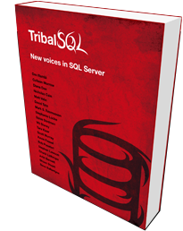
Who Am I? What Am I Doing Here?
Catallaxy Services
Curated SQL
Tribal SQL
@feaselkl

Slide 3
Power BI
Power BI is an interactive data visualization tool. It comes with a number of built-in visualizations, including:
Bar and stacked bar charts
Line and area charts
Scatterplots
Maps, funnels, treemaps, gauges, etc.
These out-of-the-box visuals work well, but won’t cover every scenario.

Slide 4
Expansion Points
When what comes out of the box isn’t enough, Power BI also offers two major places for expansion:
Inline display of visuals from R
Custom visuals

Slide 5
Motivation
Today’s talk will focus on finding and using custom Power BI visuals. Our theme of choice is baseball statistics.

Slide 6
Agenda
Getting Custom Visuals
Demos of specific custom visuals
Aquarium
Sparkline
Box and Whisker
Tornado (plus Smart Filter)
Gap Analysis
Radar Chart

Slide 7
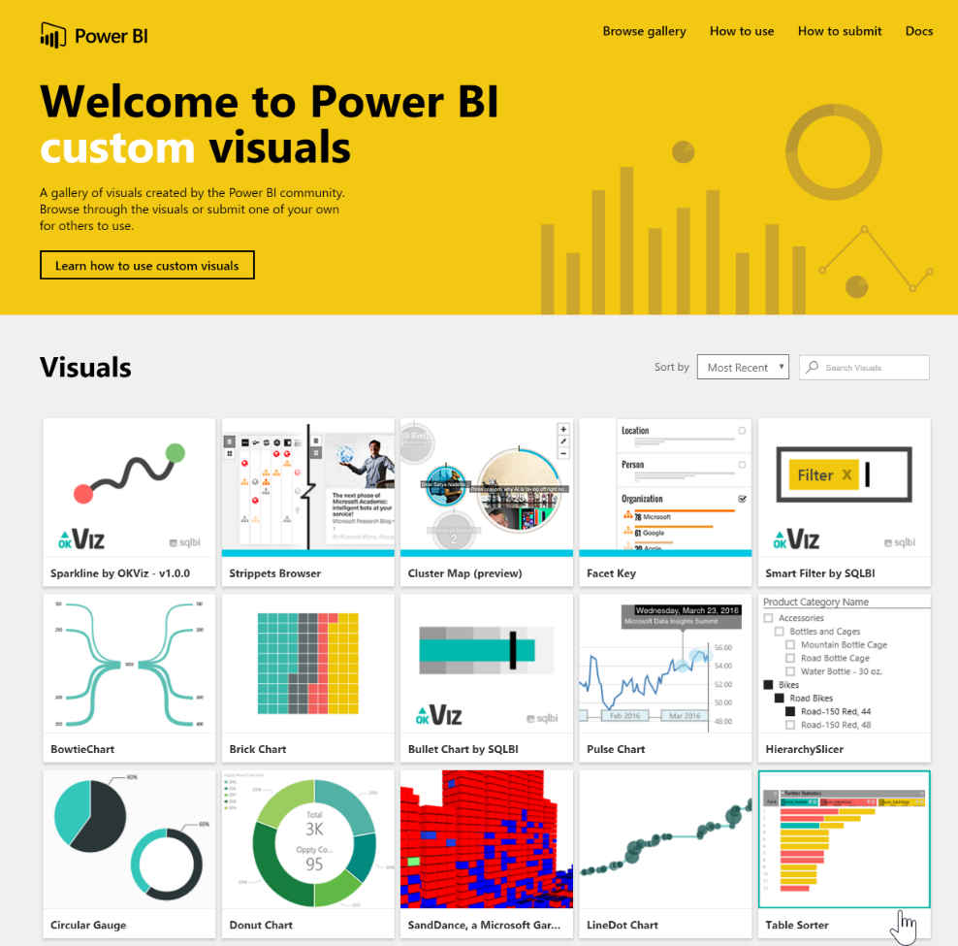
Getting Custom Visuals
Custom visuals are available at the Power BI custom visuals gallery (https://app.powerbi.com/visuals/).

Slide 8
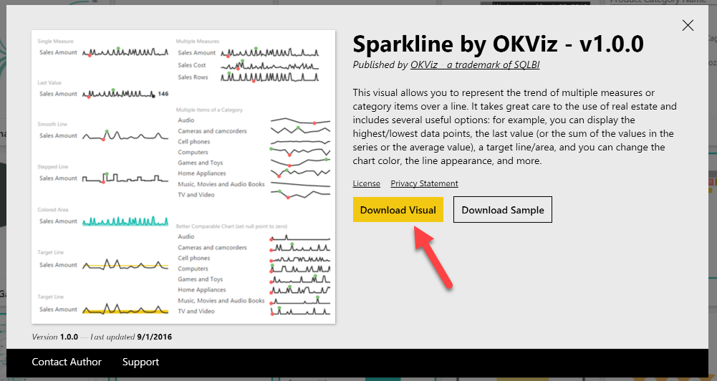
Getting Cutom Visuals
Click on an interesting-looking custom visual and you have the option to download the visual, as well as a Power BI Desktop file which shows off the visual.

Slide 9
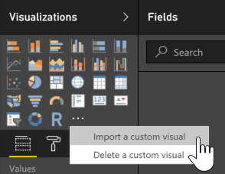
Getting Custom Visuals
To import a visual, open Power BI Desktop and click the ellipsis (…) button on the Visualizations menu and select the “Import a custom visual” option.

Slide 10
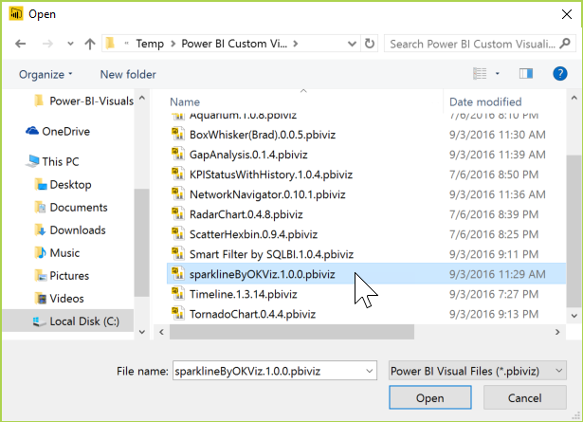
Getting Custom Visuals
Navigate to where you downloaded the custom visual and select it.

Slide 11
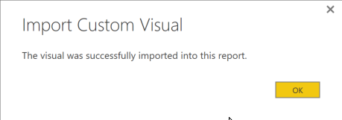
Getting Custom Visuals
After a moment, the import should succeed.

Slide 12
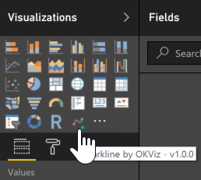
Getting Custom Visuals
You will then see the new visual as an option on your Visualizations panel.

Slide 13
Prep Work
We will use the following data sets in this talk:
Sean Lahman’s baseball database (http://www.seanlahman.com/baseball-archive/statistics/)
Custom data sets (https://github.com/feaselkl/PowerBIVisuals)

Slide 14
Off To The Races!
The rest of this talk will be demo-driven.

Slide 15
Wrapping Up
There are a number of custom visuals available within Power BI. You can also create your own custom visuals.
To learn more, go here: http://CSMore.info/on/powerbiviz
And for help, contact me: feasel@catallaxyservices.com | @feaselkl

